Slide 1
LET’S PROTECT RAINFORESTS

Slide 2
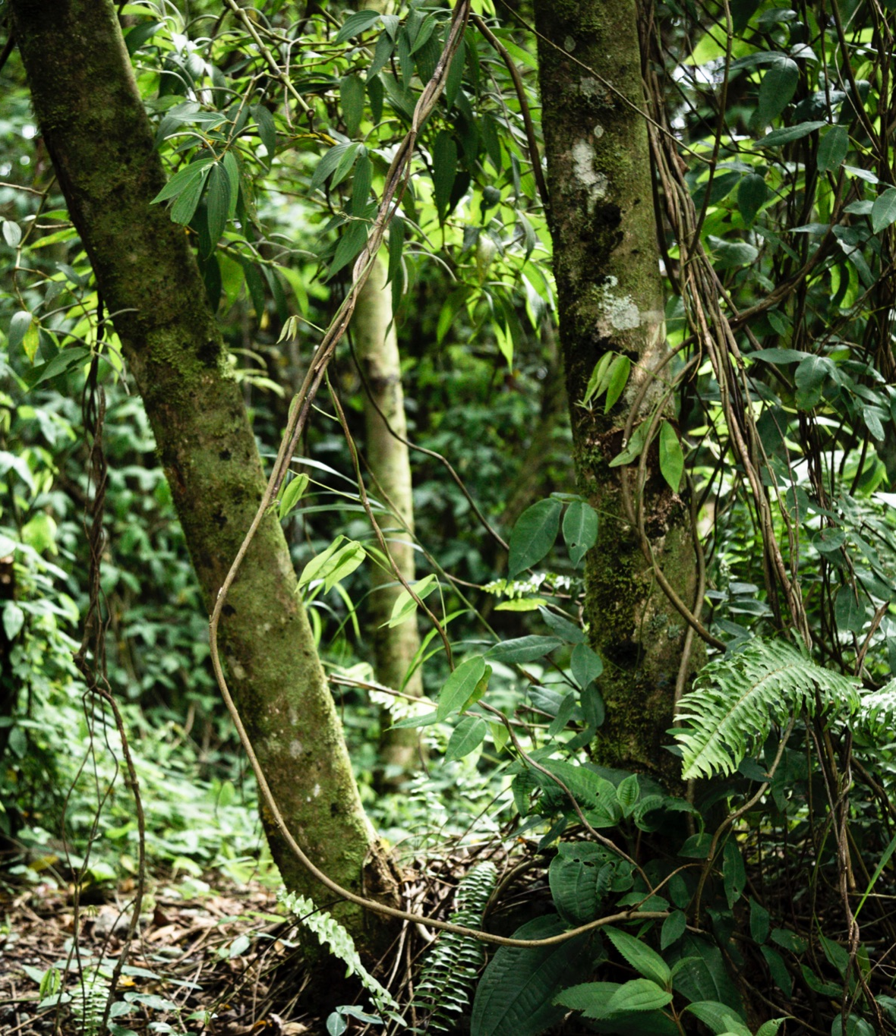



Problem
Rainforests grew over 14 percent of the land on Earth now cover only about 6 percent.
If current deforestation continue, these critical habitats could disappear within the next 100 years.

Slide 3
Where is the Rainforest?
Rainforesets occupy the northwestern part of Brazil and large areas of Colombia, Peru and other South American countries.

Slide 4

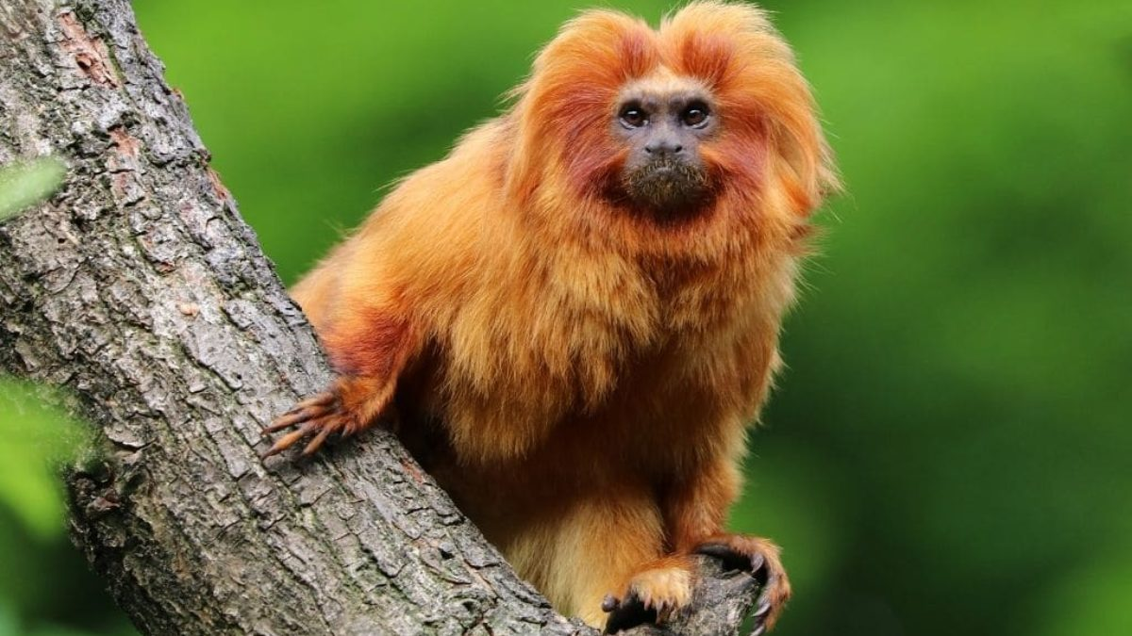
Life in the Rainforests

Slide 5



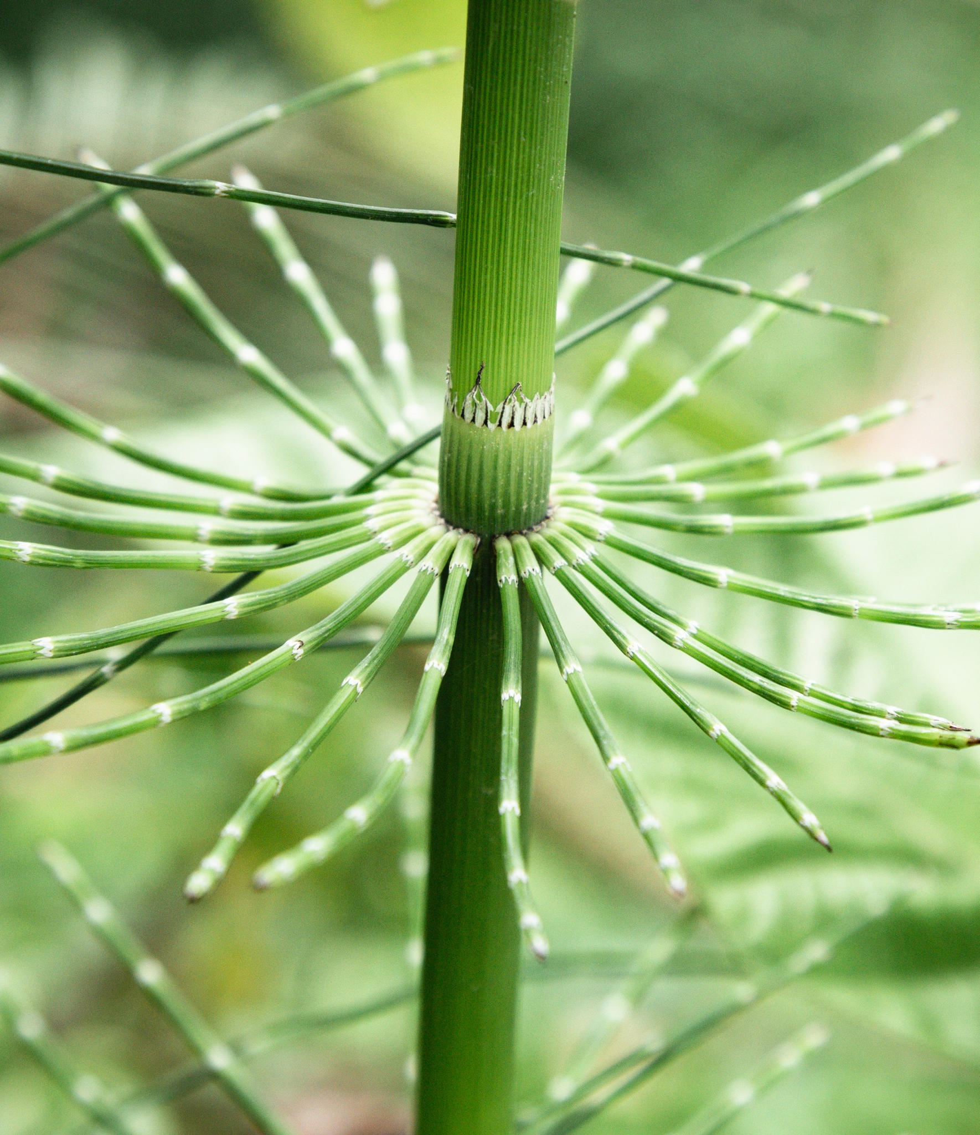
Life in the Rainforests
It contains:
one in 10 known species on Earth
40,000 plant species
3,000 freshwater fish species
more than 370 types of reptiles
over 2,000 new species of plants and vertebrates, including a monkey that purrs like a cat.

Slide 6

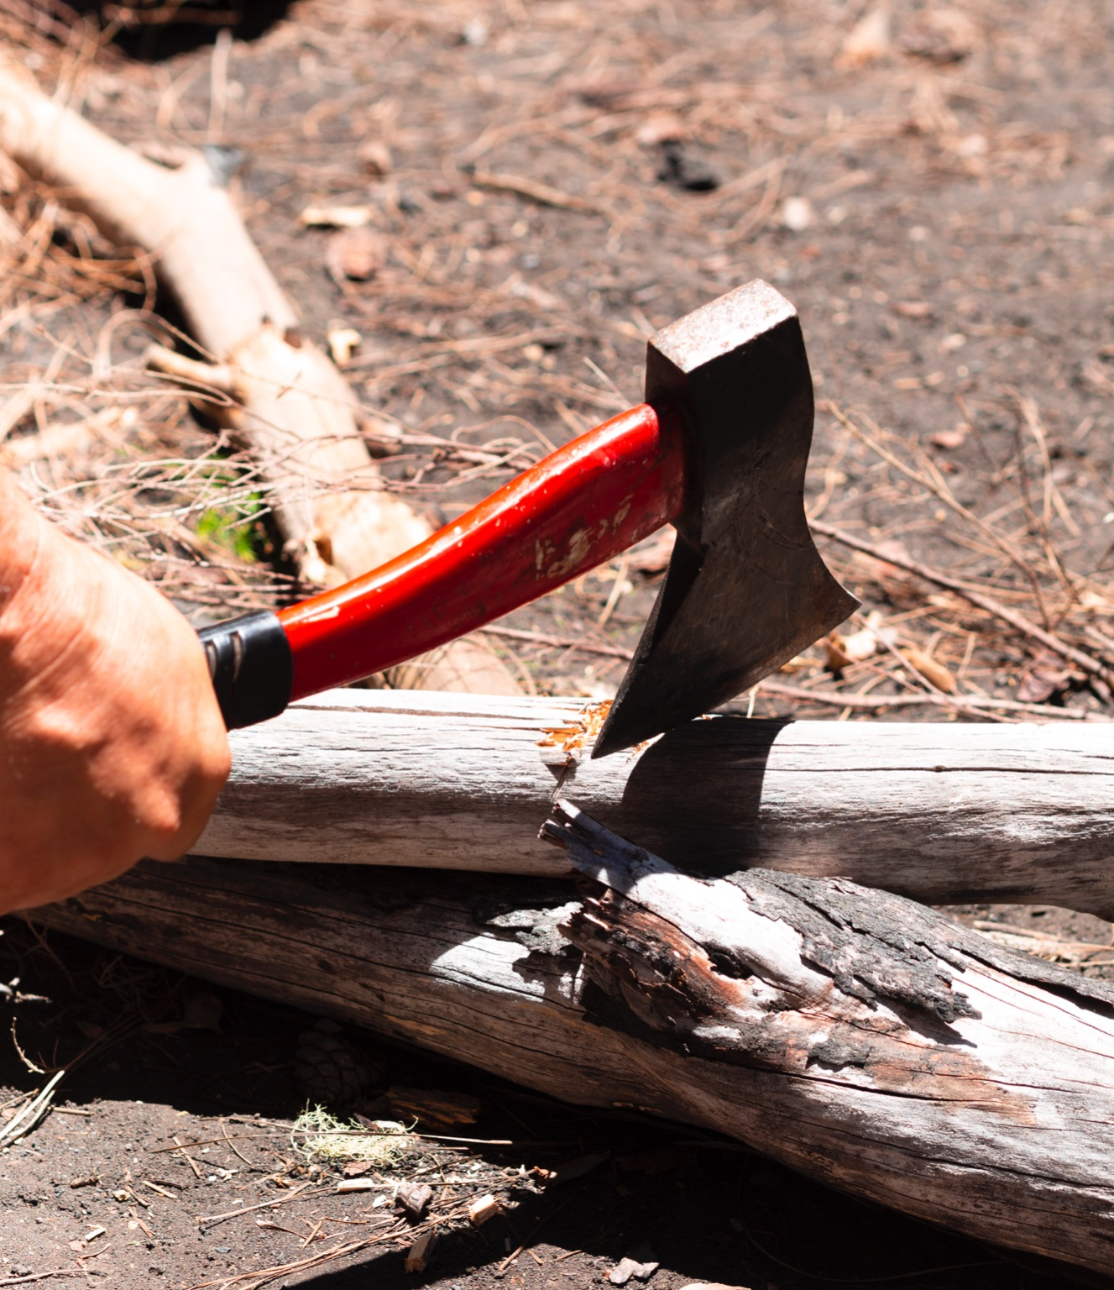

Threats
Deforestation
Climate
Agricultural expansion
Mining
Illegal Wildlife Trade

Slide 7
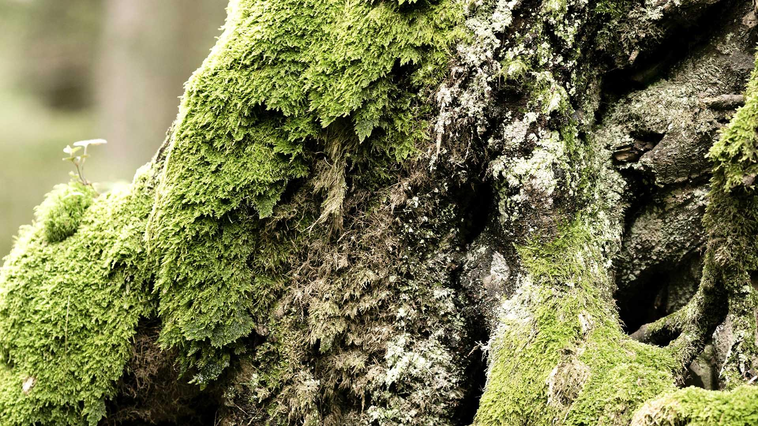
A Picture is Worth a Thousand Words

Slide 8

Consequences
increase in global warming
extinction of many species of animals
loss of biodiversity
disruption of local ecosystems
release of greenhouse gases into the atmosphere

Slide 9

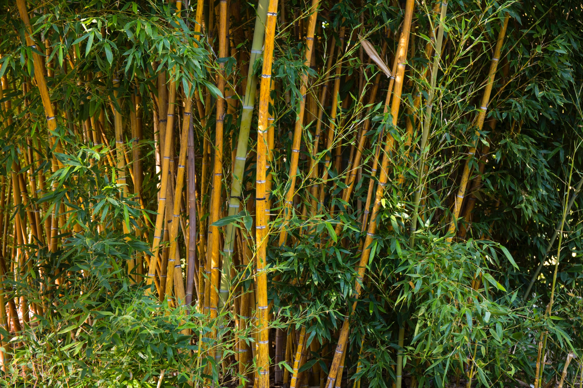

The Solution
What to do

Slide 10
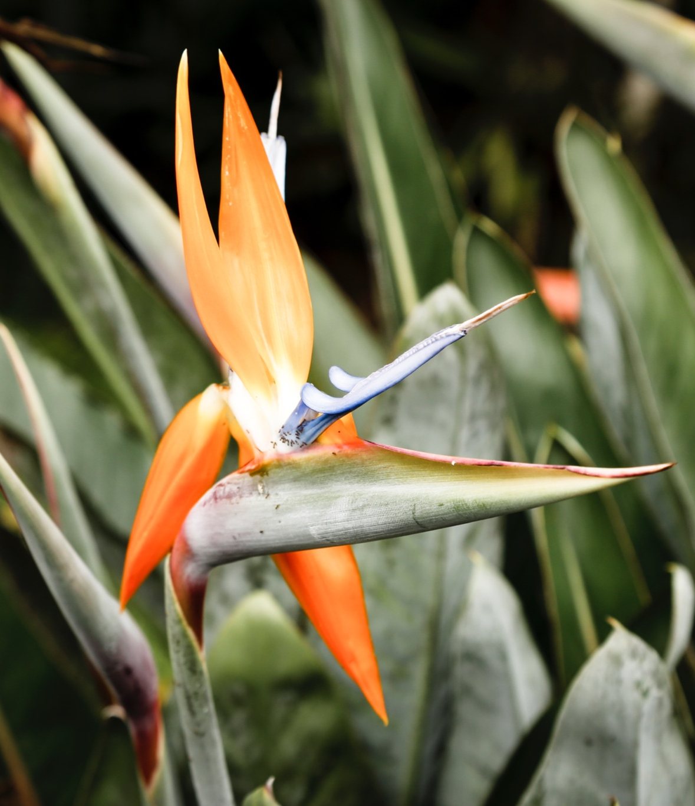
Eat Less Beef
Check the Ingredient Label
Buy Responsibly Sourced Materials and Foods
Reduce Your Carbon Footprint
Support Organizations Dedicated to Rainforest Preservation

Slide 11
Great Ideas Can Change the World
Thank you for attention!

